Slide 1
Hyperledger Indy
[ Ubuntu + Docker ]

Slide 2
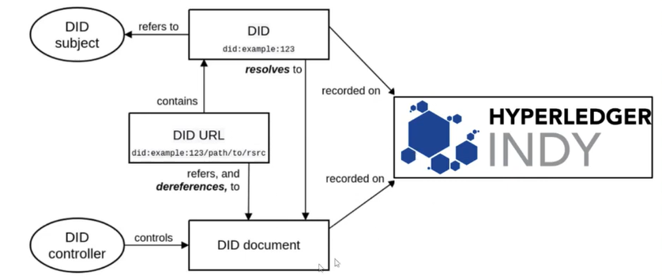
Docker container running

Slide 3
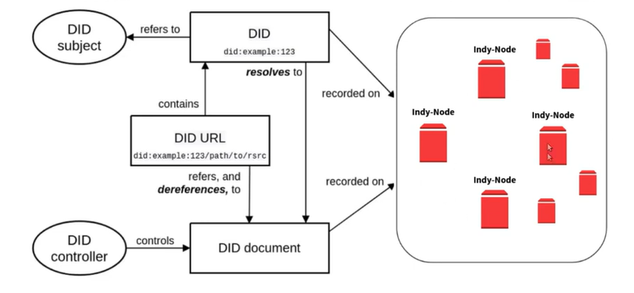
Docker container running

Slide 4
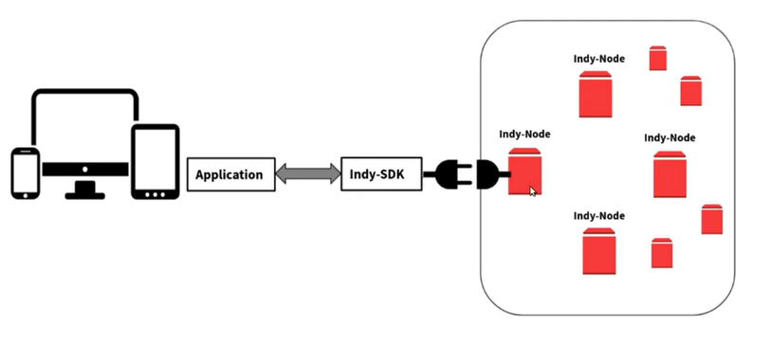
Docker container running

Slide 5
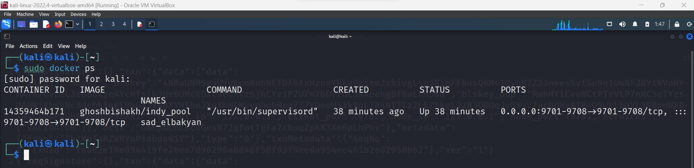
Docker container running

Slide 6
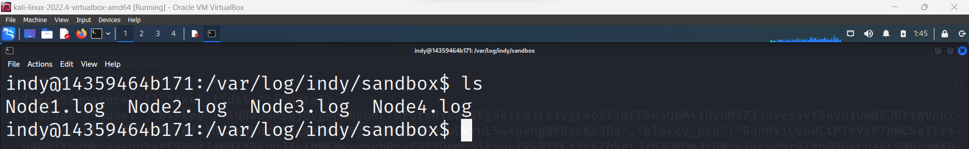
Indy Nodes

Slide 7
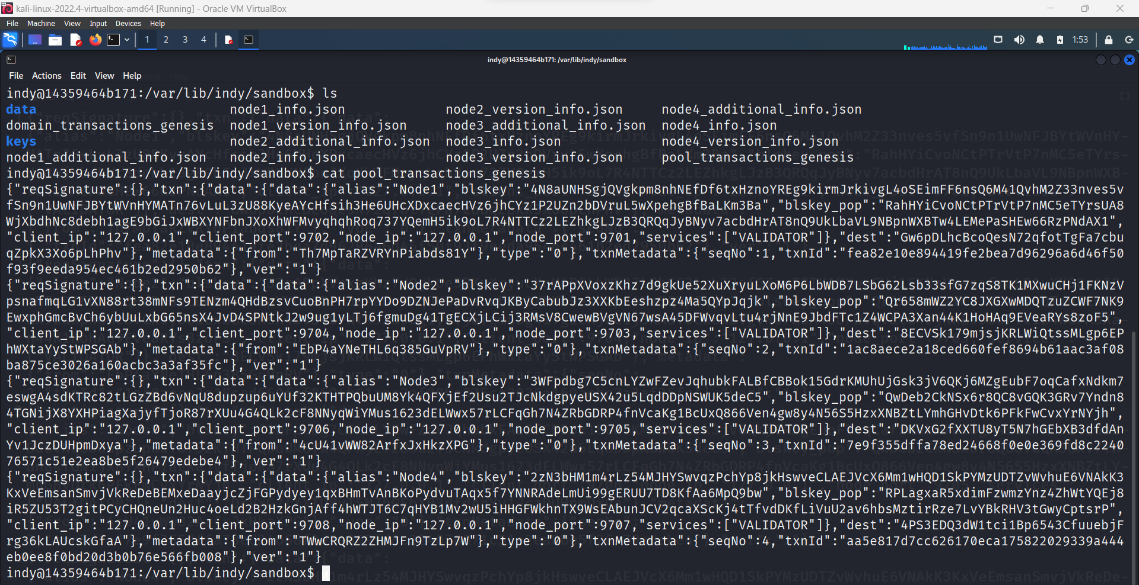
Indy Nodes

Slide 8
Indy Nodes

Slide 9
Indy Nodes

Slide 10
Indy Nodes

Slide 11
Indy Nodes

Slide 12
Indy Nodes

